Slide 1
Recycling Jobs Day
Nunez Community College
November 5, 2025

Slide 2
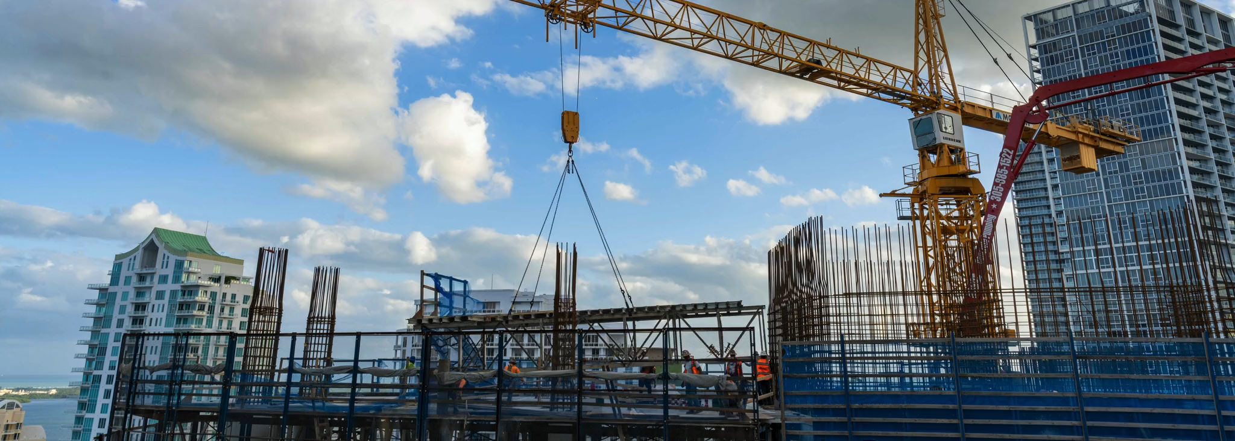

Slide 4



  ReMA is the trade association representing the recycled materials industry, with over 1,700 members. ReMA members process, broker and consume metals, such as steel and aluminum, as well as paper, plastics, glass, textiles, rubber and electronics, whether sourced from commercial, industrial or residential operations.
ReMA and our members play a critical role in providing recycled materials to America’s manufacturing industries. The recycled materials industry is integral to the U.S. economy, transforming surplus and end-of-life materials into essential components of daily life and providing high-quality renewable resources for everything from national infrastructure to consumer products. The roads we drive on and the cars we drive in, the rebar that holds up our buildings, the wires that bring electricity and communications into our homes and offices, and the boxes that bring consumer goods and food to our homes are all made with recycled materials. As a crucial part of the global manufacturing supply chain, recycled materials are integral to maintaining the nation’s economic strength and ensuring resource availability into the future.
    Sustainable – helping protect the environment
    Resilient – providing materials that strengthen the economy
    Essential – providing what we need to make everyday life better
Notes:
ReMA is the trade association representing the recycled materials industry, with over 1,700 members. ReMA members process, broker and consume metals, such as steel and aluminum, as well as paper, plastics, glass, textiles, rubber and electronics, whether sourced from commercial, industrial or residential operations.
ReMA and our members play a vital role in combatting climate change by promoting safe, economically sustainable and environmentally responsible recycling. Our new tagline conveys the industry’s core benefits to society and attributes.
Sustainable – helping protect the environment
Resilient – providing materials that strengthen the economy
Essential – providing what we need to make everyday life better

Slide 5

The Recycled Materials Industry

Slide 6
ReMA Chapters
Gulf Coast Chapter | Arkansas, Kansas, Louisiana, Mississippi, New Mexico, Oklahoma, Texas
Indiana Chapter | Indiana
Michigan Chapter | Michigan
Mid-America Chapter | Illinois, Missouri
Mid-Atlantic Chapter | Delaware, District of Columbia, Maryland, Pennsylvania (part)
New England Chapter | Connecticut, Maine, Massachusetts, New Hampshire, Rhode Island, Vermont
New Jersey Chapter | New Jersey
Ohio Valley Chapter | Kentucky, Ohio (part), West Virginia (part)
Pacific Northwest Chapter | Alaska, Oregon, Washington
Paper Stock Industries | National
Pittsburgh Chapter | Pennsylvania (part), West Virginia (part)
Rocky Mountain Chapter | Arizona, Colorado, Idaho, Montana, Utah, Wyoming
Southeast Region Chapter | Alabama, Florida, Georgia, North Carolina, Puerto Rico, South Carolina, Tennessee, Virginia
Upper Midwest Chapter | Iowa, Minnesota, Nebraska, North Dakota, South Dakota, Wisconsin
West Coast Chapter | California, Hawaii, Nevada
Empire Chapter (NY) | New York (region)
New York Chapter (NY) | New York (region)
Northern Ohio Chapter (OH) | Ohio (region)
ReMA has 18 Chapters which are networks of processers, brokers, consumers, and equipment and service providers. They are a resource for members to grow their businesses through building connections, and advocating on state and local issues. Together, we are ReMA.
Notes:
Gulf Coast Chapter
Arkansas, Kansas, Louisiana, Mississippi, New Mexico, Oklahoma, Texas
Indiana Chapter
Indiana
Michigan Chapter
Michigan
Mid-America Chapter
Illinois, Missouri
Mid-Atlantic Chapter
Delaware, District of Columbia, Maryland, Pennsylvania (part)
New England Chapter
Connecticut, Maine, Massachusetts, New Hampshire, Rhode Island, Vermont
New Jersey Chapter
New Jersey
Ohio Valley Chapter
Kentucky, Ohio (part), West Virginia (part)
Pacific Northwest Chapter
Alaska, Oregon, Washington
Paper Stock Industries
National
Pittsburgh Chapter
Pennsylvania (part), West Virginia (part)
Rocky Mountain Chapter
Arizona, Colorado, Idaho, Montana, Utah, Wyoming
Southeast Region Chapter
Alabama, Florida, Georgia, North Carolina, Puerto Rico, South Carolina, Tennessee, Virginia
Upper Midwest Chapter
Iowa, Minnesota, Nebraska, North Dakota, South Dakota, Wisconsin
West Coast Chapter
California, Hawaii, Nevada
Empire Chapter (NY)
New York (region)
New York Chapter (NY)
New York (region)
Northern Ohio Chapter (OH)
Ohio (region)

Slide 7
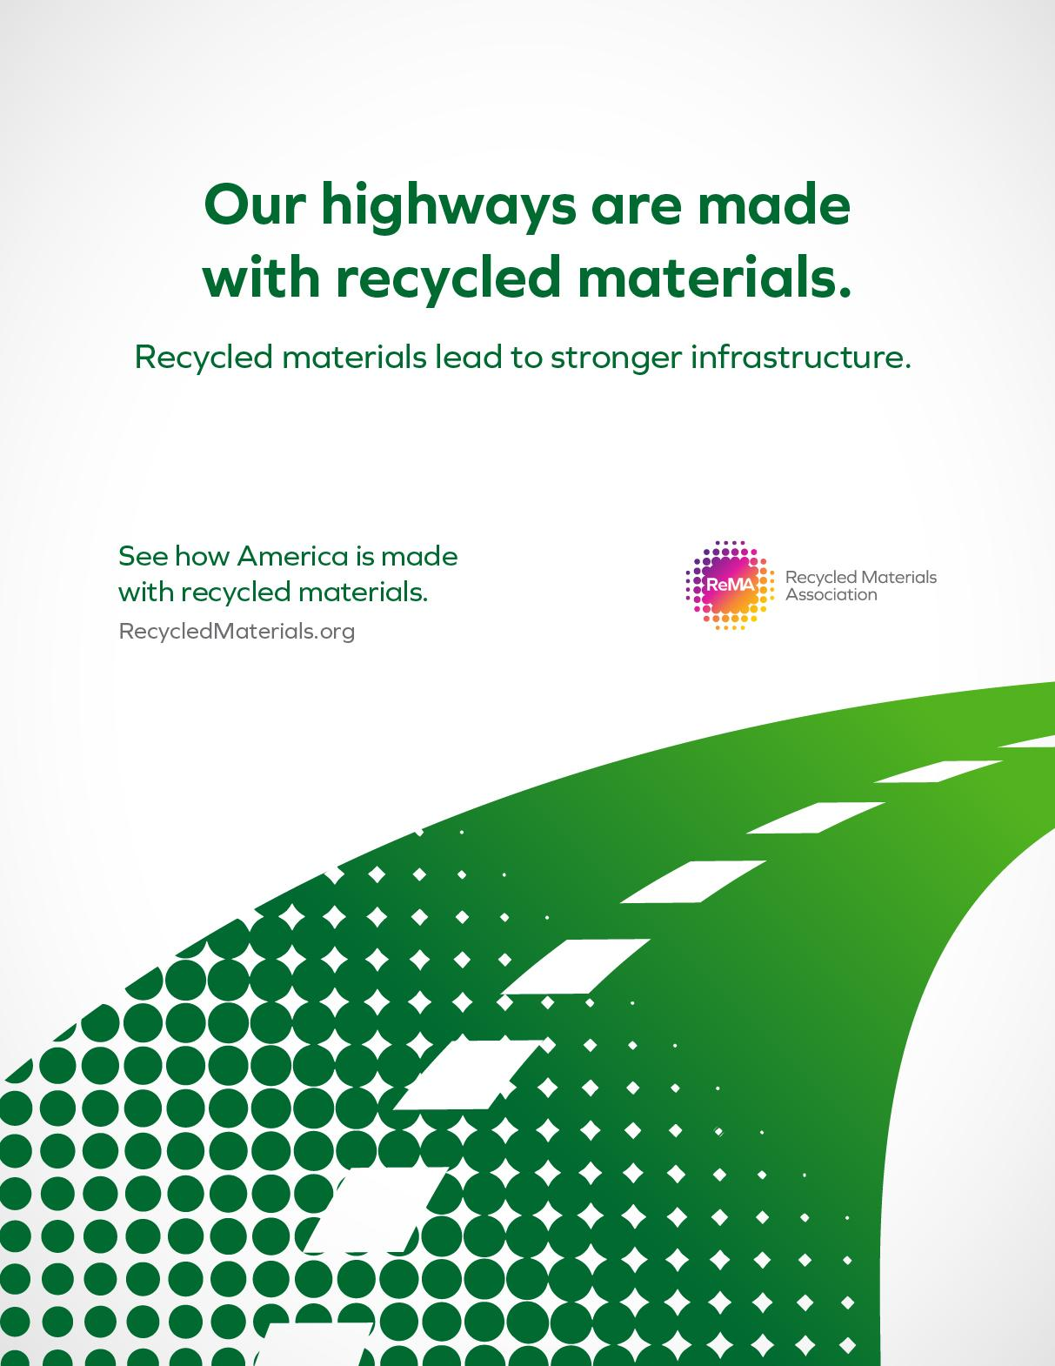

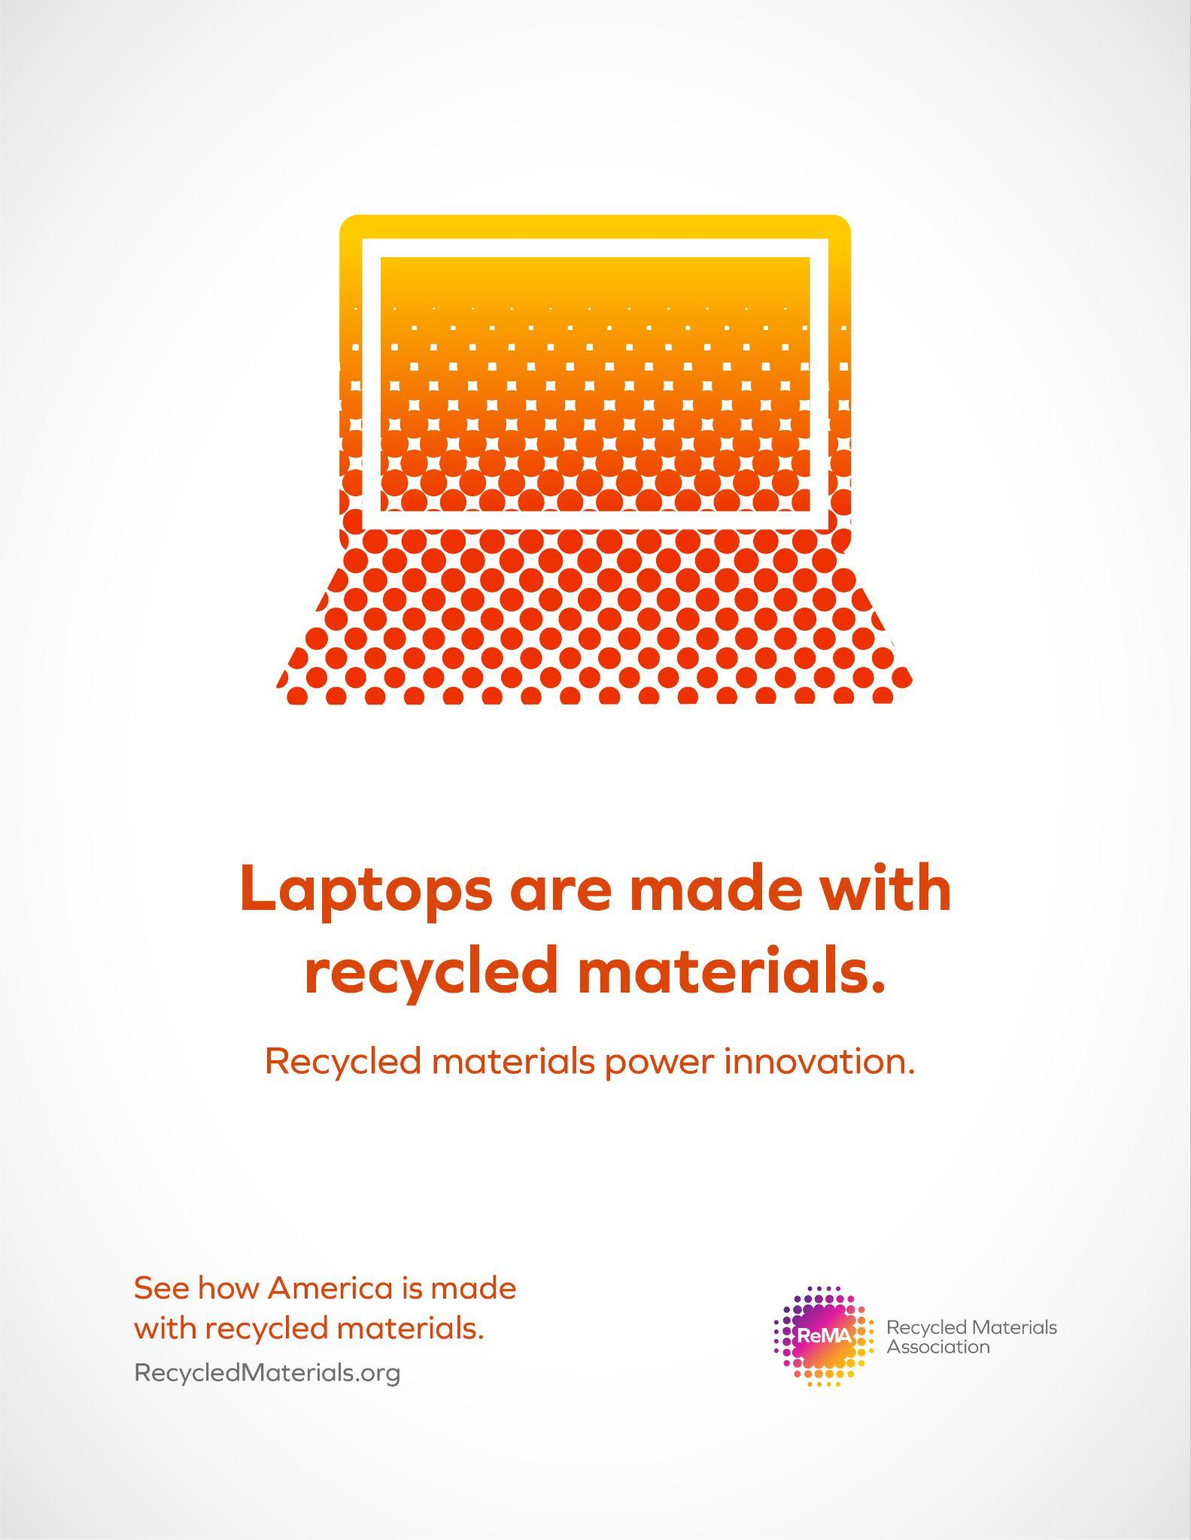
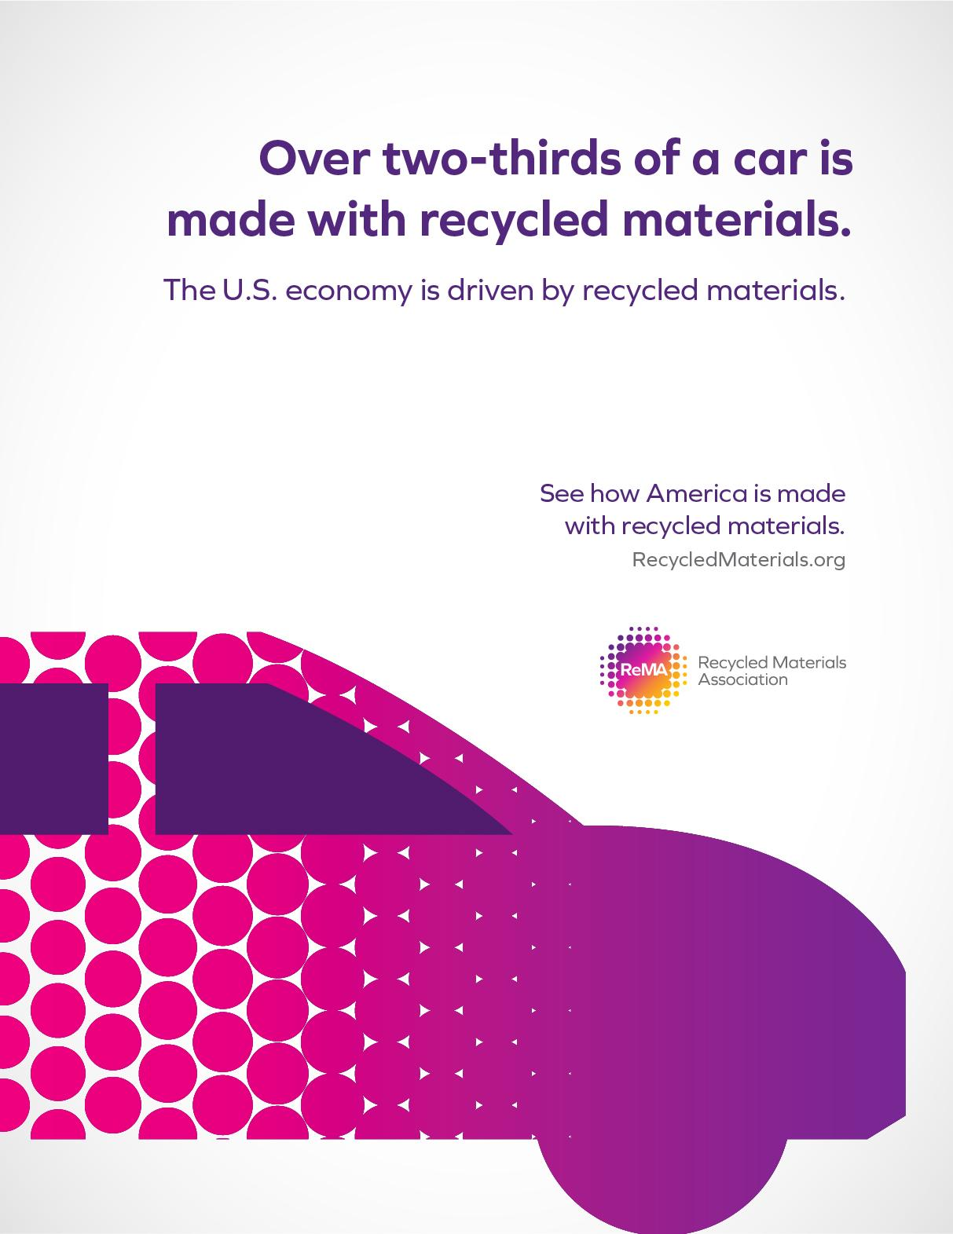
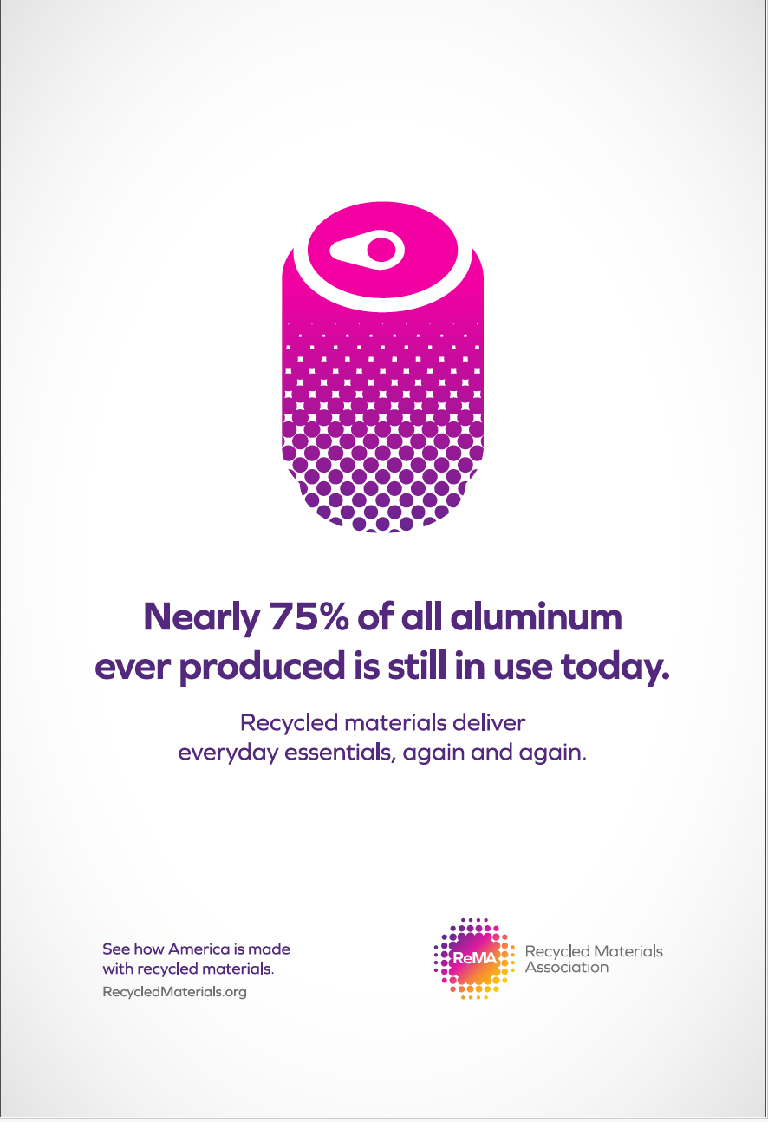
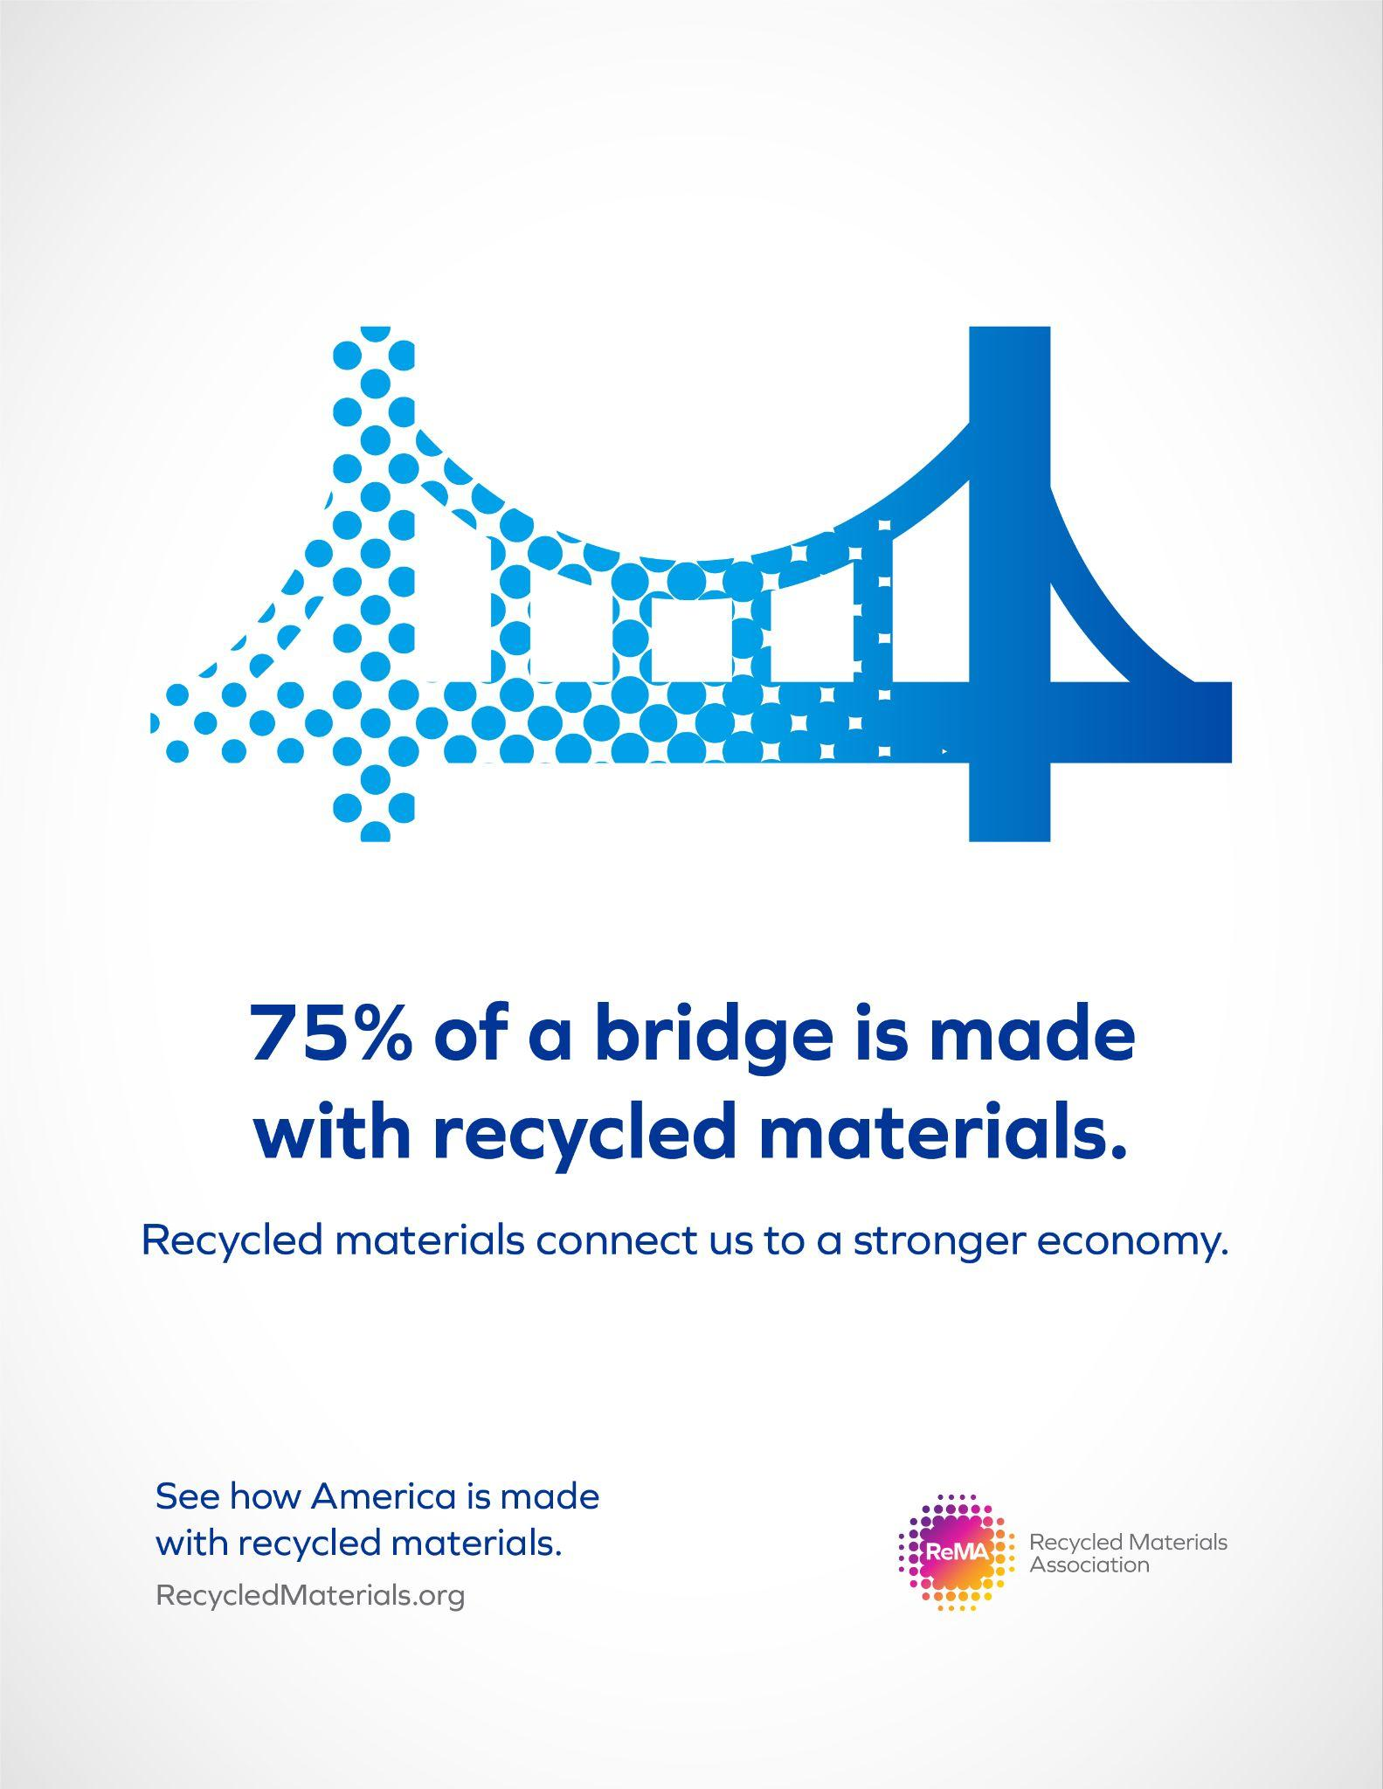
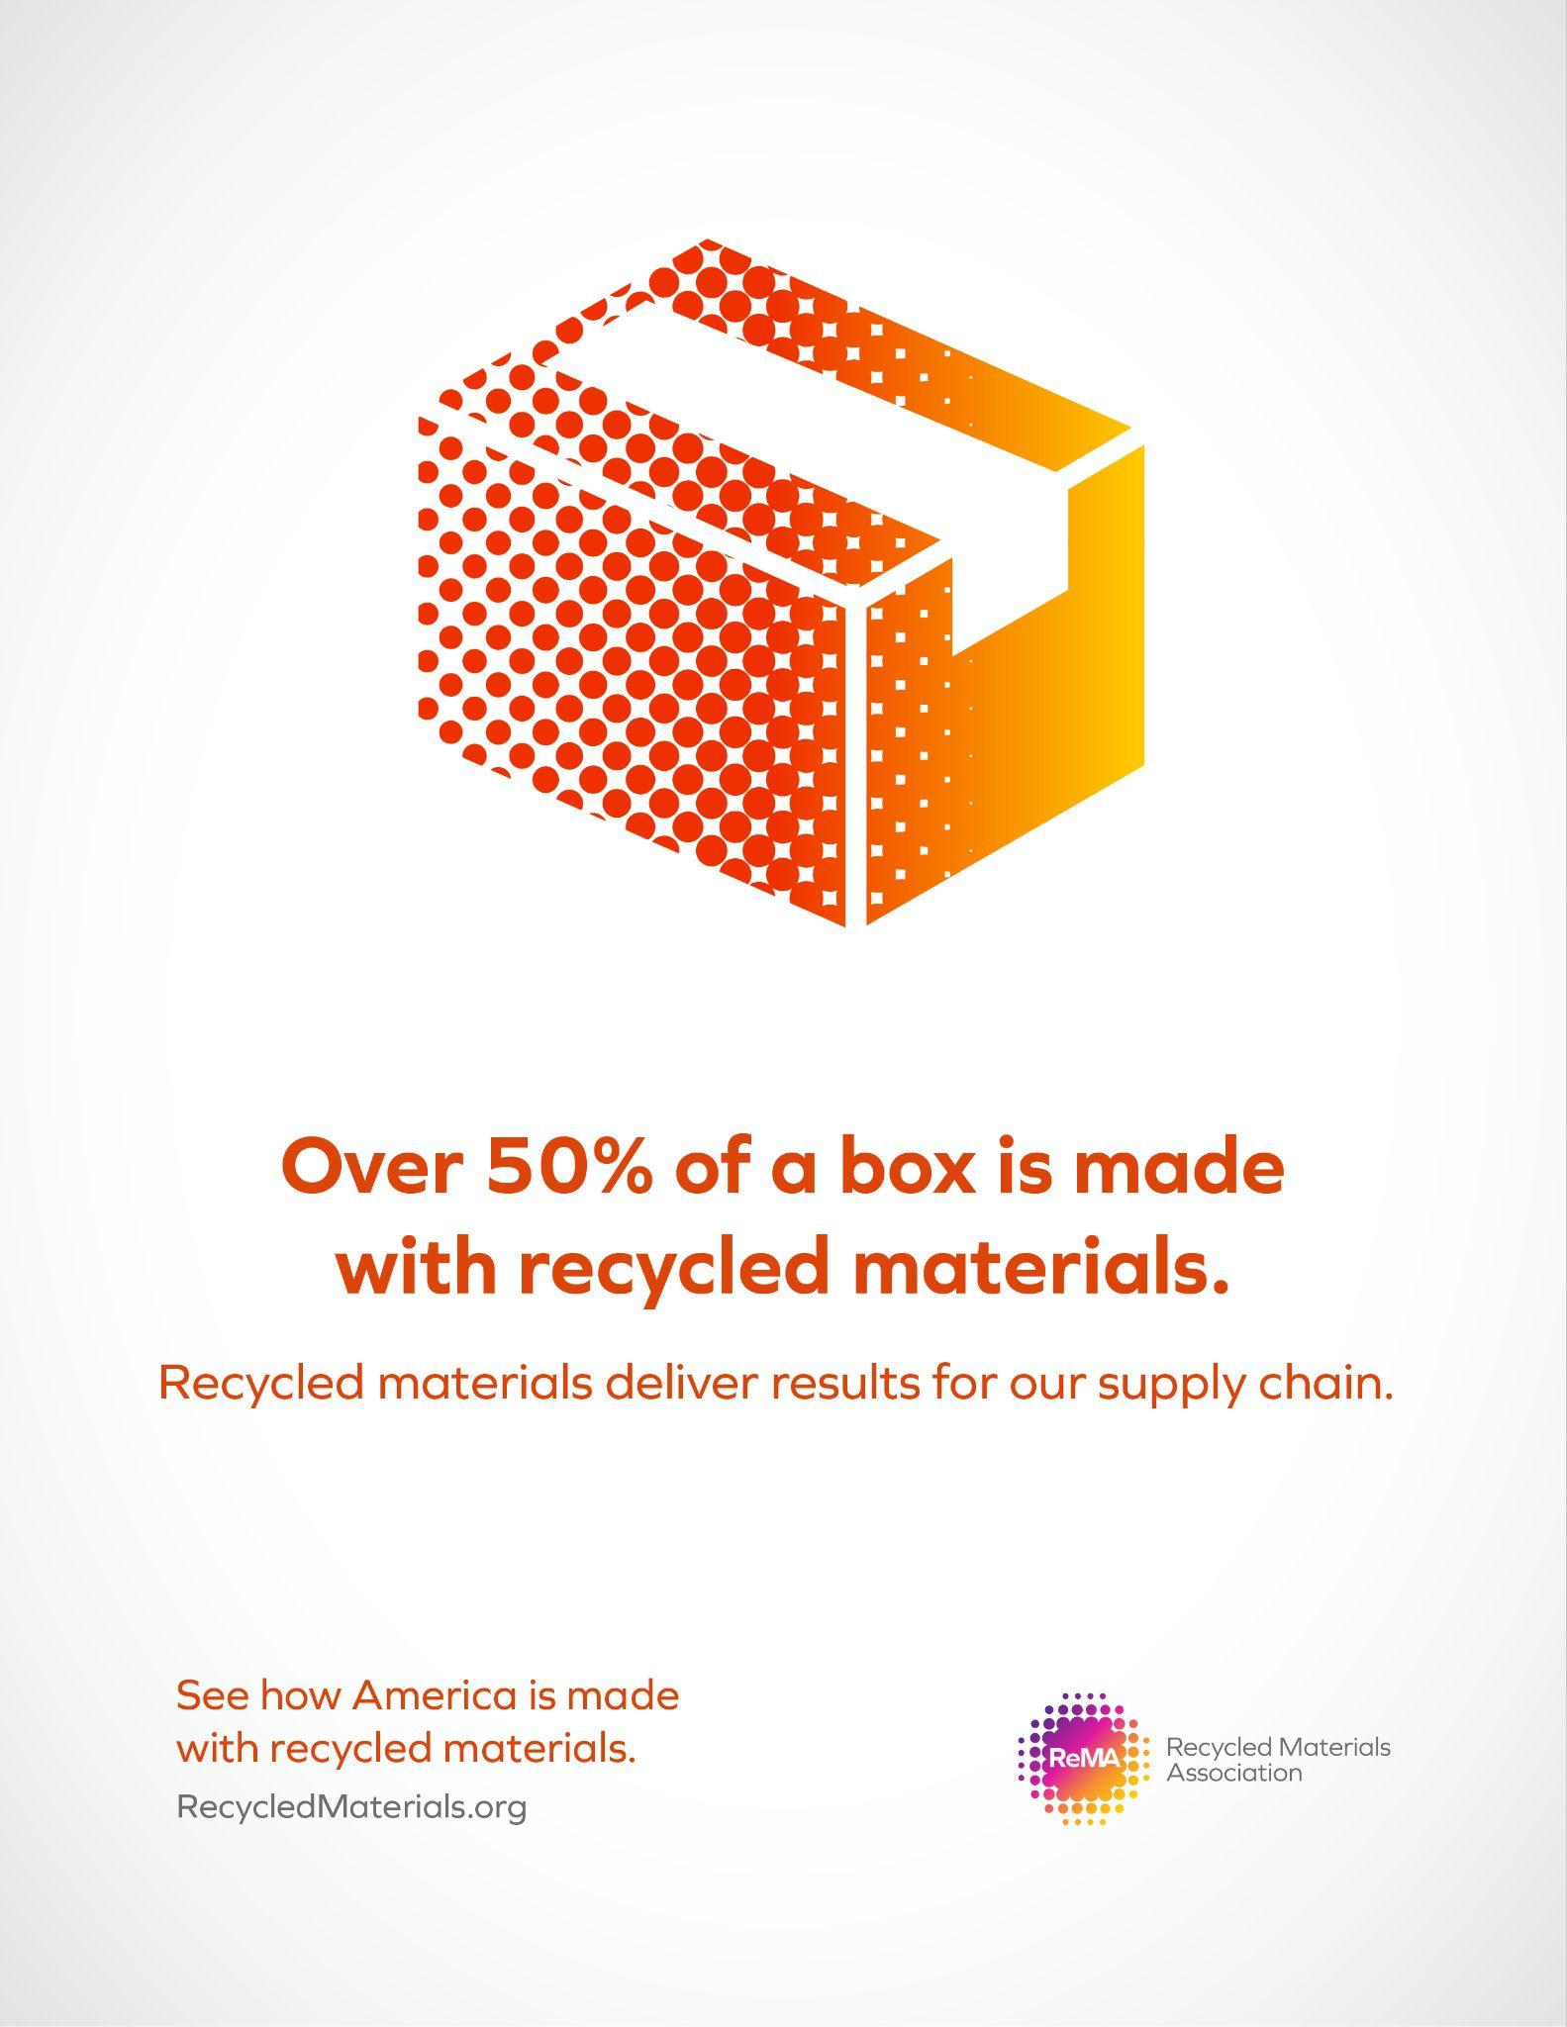
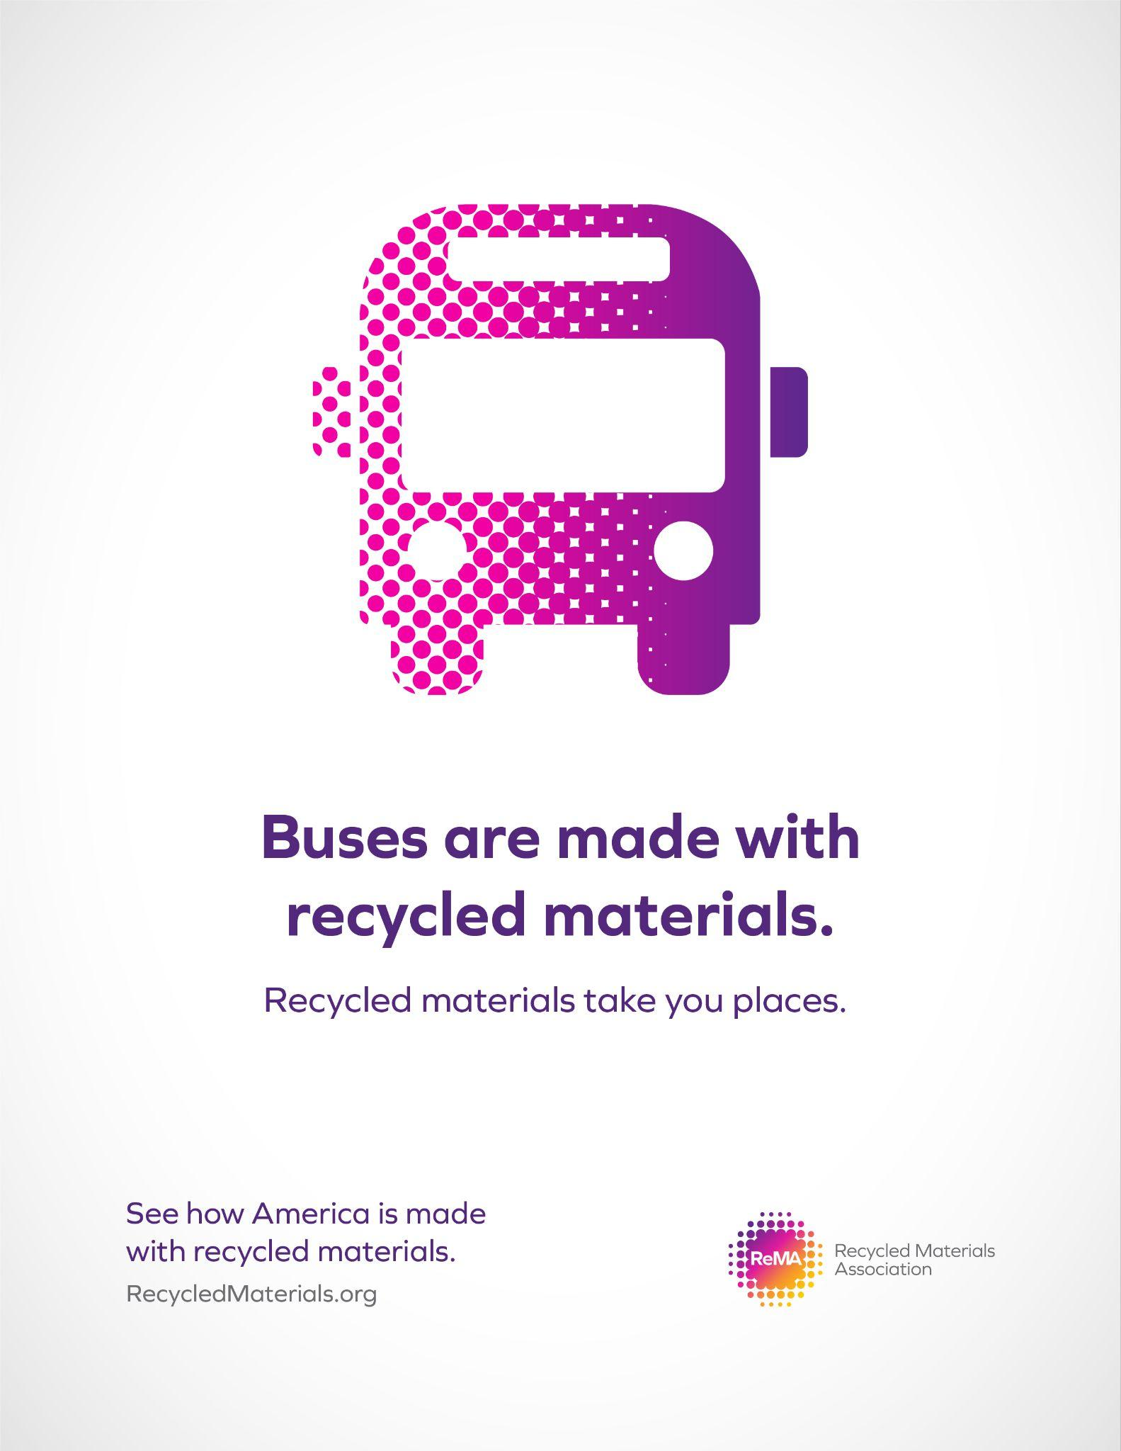


Slide 8
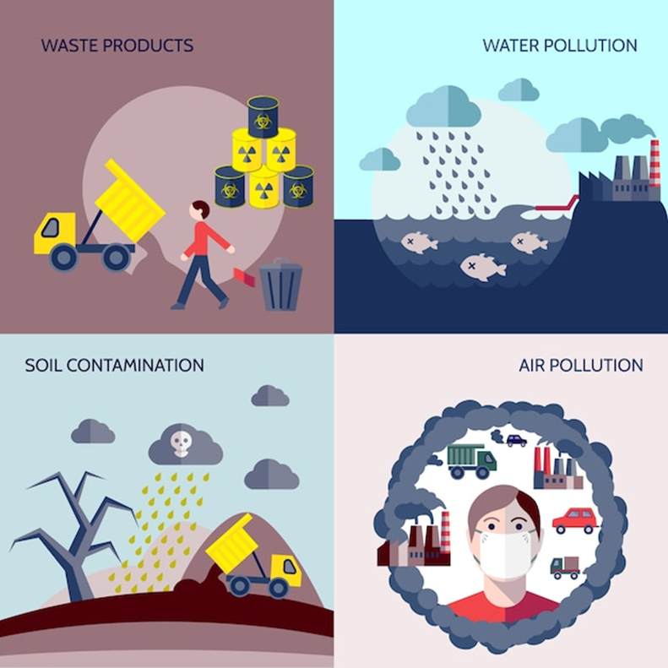
Environment and Sustainability
Recycling provides a consistent and reliable stream of high-quality materials, and gives us a way to renew scarce resources we would otherwise run out of.
Recycled materials make a positive environmental impact by:
Protecting natural resources through sustainable alternatives, creating less dependence on scarce resources, and reducing the need to drill, mine, or log for new raw material
Reducing carbon emissions by using cleaner processes
Reducing waste by ensuring more material stays in use

Slide 9
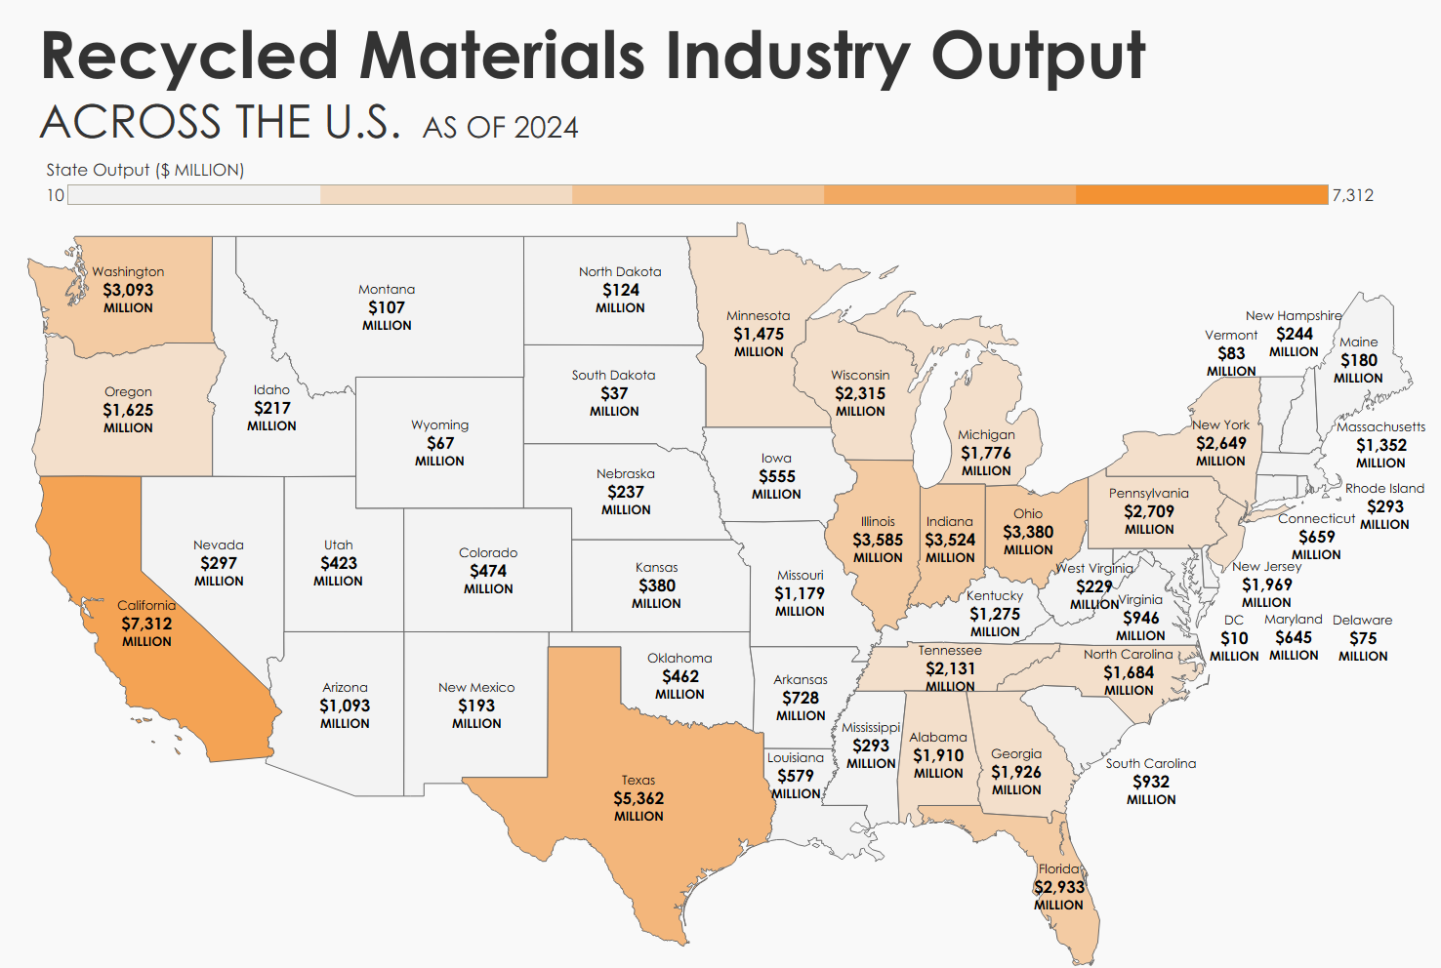
THOUSANDS
Notes:
Source: ReMA and John Dunham & Associates, Economic Impact Study, U.S.-Based Recycling Industry, 2025.

Slide 10

The recycling operations within the industry directly supported nearly 171,470 FTE jobs in the United States.

Slide 11
Local vs State Economic Impact
Steps for grabbing the economic Impact information from ReMA's Economic Impact Report:
Go to ReMA's interactive Economic Impact Report (https://www.recycledmaterials.org/our-impact/#economic-impact-map)
For the State data, underneath the map in the “State/Nation” section, click your state in the dropdown.
  This will be your state specific information, you can screen-grab, or have the economic report emailed to you
For the Local data, underneath the “congress” section, click your specific state AND congressional district.
Local
(Congressional District)
Specific State
ReMA's Economic Impact Study: U.S.- Based Recycled Materials Industry 2024

Slide 12

Jobs and
Benefits

Slide 13
Careers in Recycled Materials: Job Categories
Collection & Transportation
Facility & Equipment Management
Collection truck drivers and helpers
Route managers and logistics coordinators
Dispatch and fleet management
Equipment operators (balers, forklifts, cranes)
Mechanics and maintenance technicians
Facility operators
Sorting & Processing
Technology & Advanced Systems
Material sorters and handlers
Metals graders and inspectors
Quality control specialists
Robotics technicians (AI sorting systems)
Software engineers and data analysts
Environmental and process engineers

Slide 14
Careers in Recycled Materials: Job Categories
Management & Operations
Professional & Support Services
MRF managers and operations supervisors
Production and yard managers
Safety coordinators
Human resources managers
Accountants and financial analysts
Customer service representatives
Policy analysts and economists
Marketing and compliance officers
Sales & Business Development
170,000+ workers employed nationwide
Sales representatives and account managers
Commodity traders and brokers
Business development professionals
Opportunities across all skill levels and education backgrounds
Average industry wages exceed $70,000 annually with benefits
Growing demand for tech skills (robotics, AI, data analysis)
No college degree required for many entry-level positions
Clear advancement paths from entry-level to management
Essential local work that can’t be outsourced

Slide 15



Salaries and Benefits
Salaries
Benefits
Vacation
Non-Production: $22.50 - $55.50 / hr
Production: $16.00-$25.00 / hr
Medical
Dental
Vision
Life
Retirement
Average PTO: 21 days

Slide 16

Next Week (TO BE EDITED)
Schedule
8:00 AM – Meet at Nunez and load onto the bus (one bus, two stops).
8:30 AM – Group 1 arrives at EMR; Group 2 heads to Colt.
8:45–11:00 AM – Site tours and job shadowing begin, tailored to student interests.
11:00 AM – Lunch and speed networking at both sites.
12:00–3:00 PM – Groups switch sites for second round of tours and networking.
3:15–3:30 PM – Return to Nunez.
Site Tours
In-depth walkthroughs of job tasks and workstations.
Opportunities to meet staff and ask questions.
Exposure to real-world recycling operations and career paths.
Speed networking: Rotations to connect with multiple professionals.

